Slide 1
Tut 12 & Review
Jingyu Li

Slide 2
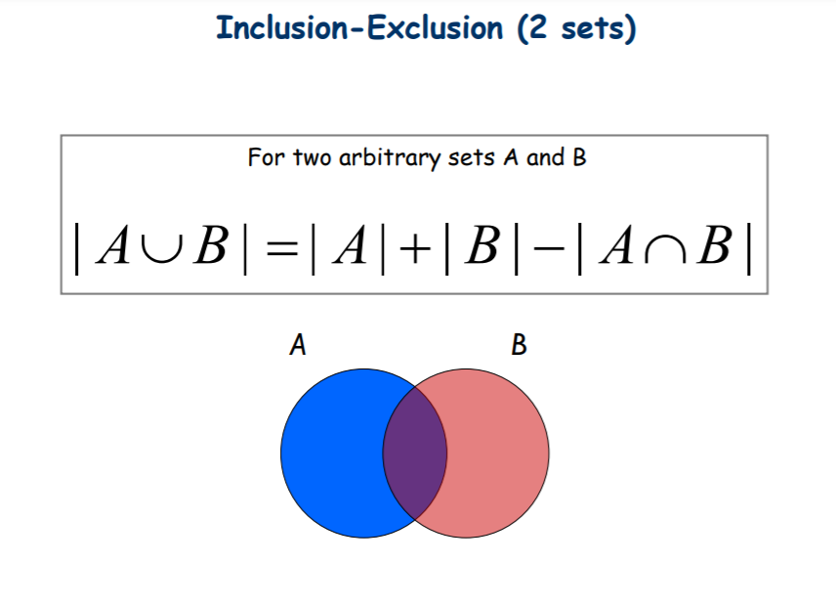


Slide 3

Q1

Slide 4
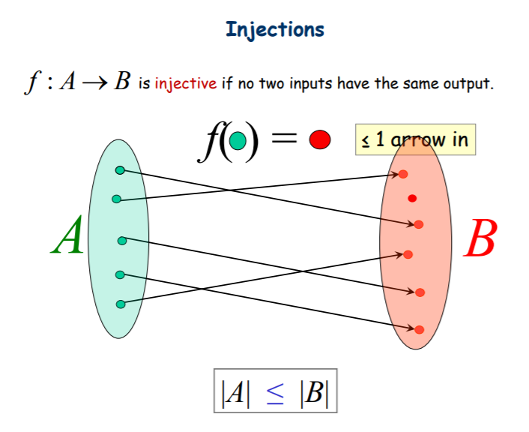
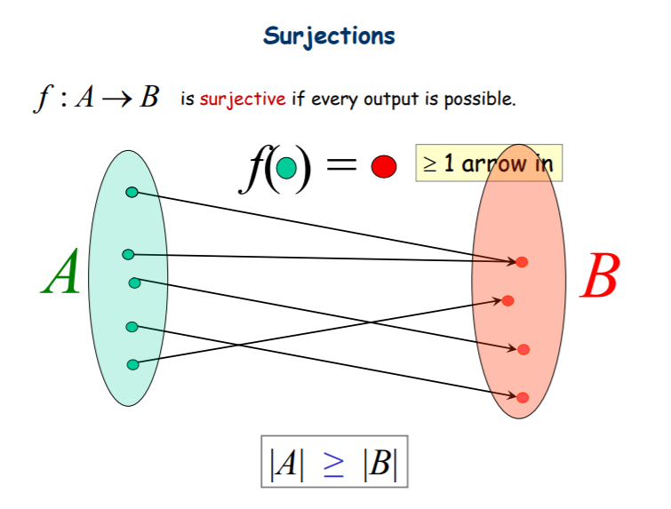
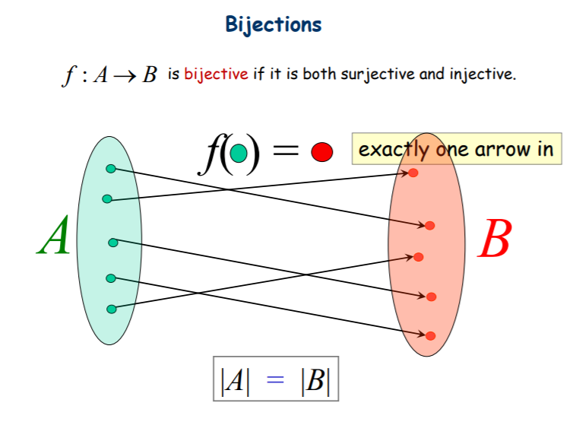

Slide 5
Q2

Slide 6

Q3

Slide 7
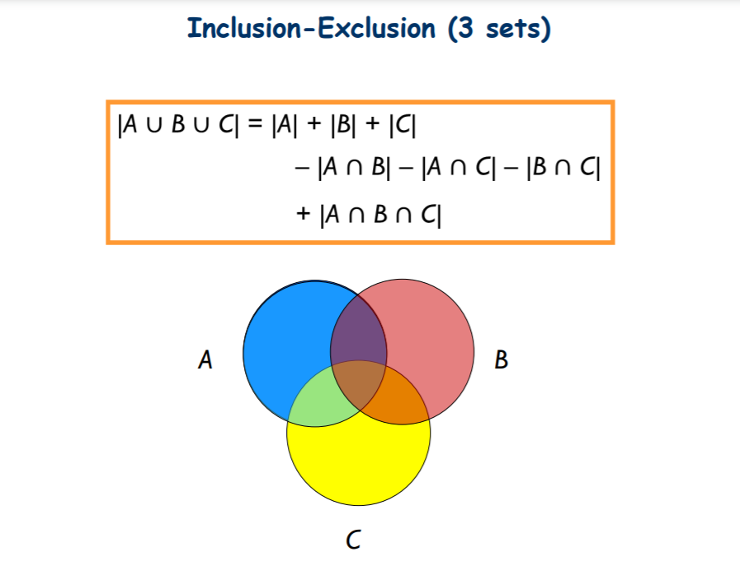

Slide 8

Q4

Slide 9
What we have learned…
1. Before midterm …
2. Graph Theory
3. Graph matching
4. Graph coloring
5. Combinatorial proof
6. Pigeon - hole theorem
7. Counting

Slide 10
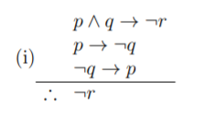

1. Before midterm …
Logic: circuit, valid check
Set: pow(S)
GCD: pouring water problem.

Slide 11


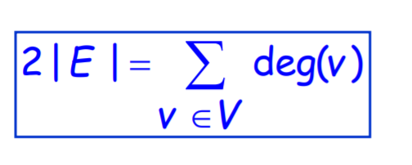

2. Graph Theory

Slide 12
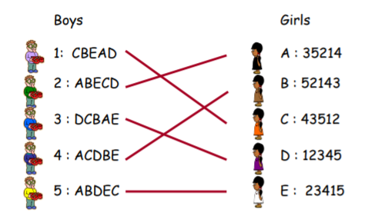

3. Graph matching

Slide 13

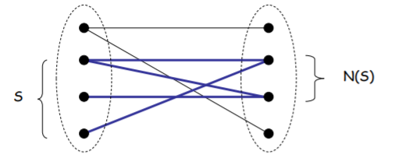
3. Graph matching

Slide 14
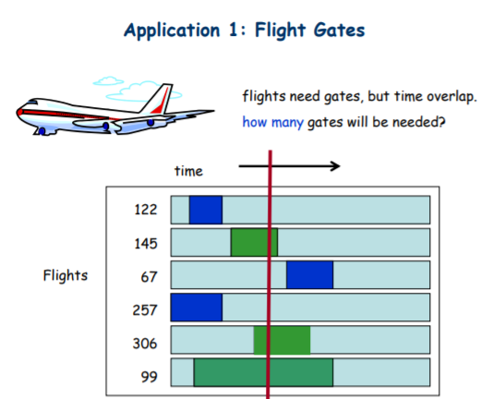
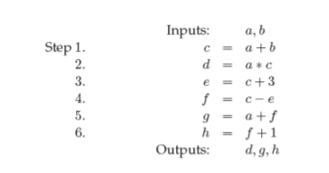
4. Graph coloring
Graph Formulation:
Register allocation, borrow books, airline, exam…

Slide 15


5. Combinatorial proof

Slide 16

6. Pigeon - hole theorem

Slide 17

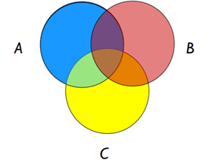

7. Counting

